Slide 1
LAB 3

Slide 2
DC Motor Basics
It translates electrical pulse to mechanical movement
It has only + and – terminals which rotate the motor in one direction
By reversing supply of motor change its direction
Maximum speed is indicated in rpm(round per minute)
Nominal voltage will vary from 1 to 150 V. As DC Volage increases, Rpm also increases
Current rating is the nominal current consumption with no load condition. It range from 25 mA to few Amp

Slide 3
DC Motor Basics
As the load increases the RPM is decreased unless voltage or current is increased
With a fixed voltage as the load increases current consumption will also be increased
If we overload the moter, it will halt and can demage the moter due to the heat

Slide 4
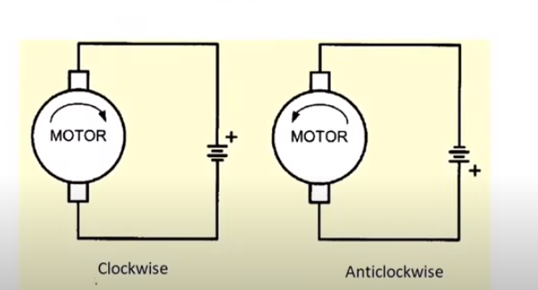
Direction of DC motor

Slide 5
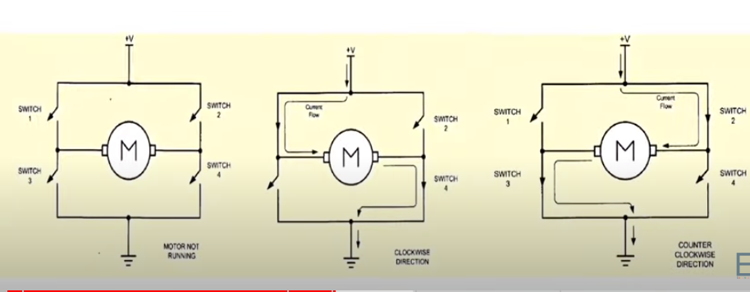
H bridge conection

Slide 6
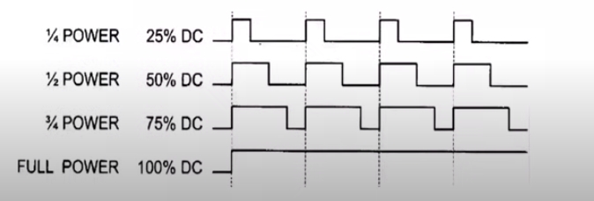
Controlling the speed of the DC motor
We can increase of decreases the motor speed by changing the amount of power to it by using PWM techniques

Slide 7
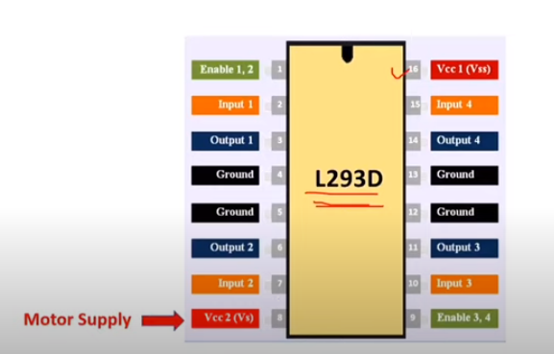


L293D DC motor driver IC
PWM for control speed
Input from 8051 for
Direction controlling
Input from 8051 for
Direction controlling

Slide 8
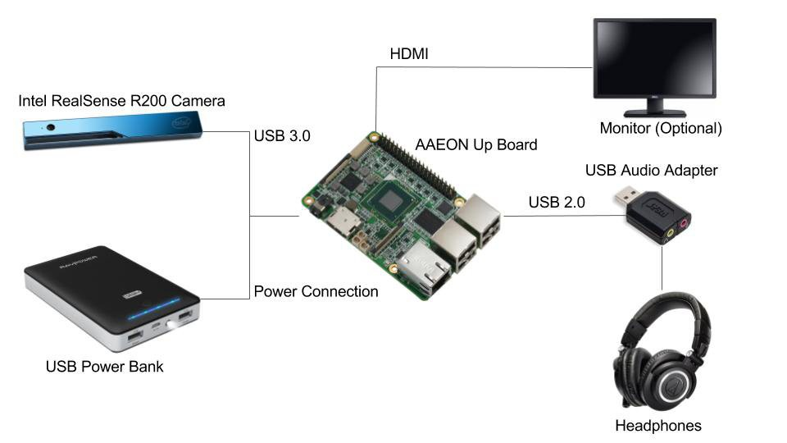
Block Diagram of Hardware Connection

Slide 9
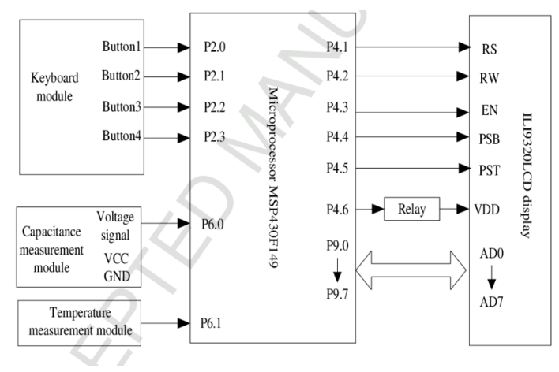

Slide 10
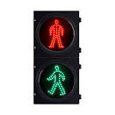
A Simplified Traffic light
Scenario

Slide 11

P
8051
P1.1
P1.0
P2.0

Slide 12
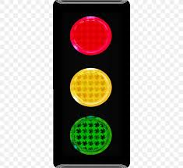
A Traffic light
Scenario

Slide 13
P
P1.4
8051
P1.3
P1.2
P1.1
P1.0
P2.0

Slide 14

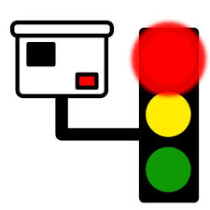

A Traffic light with AI camera
Scenario
stop

Slide 15
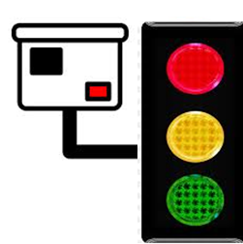
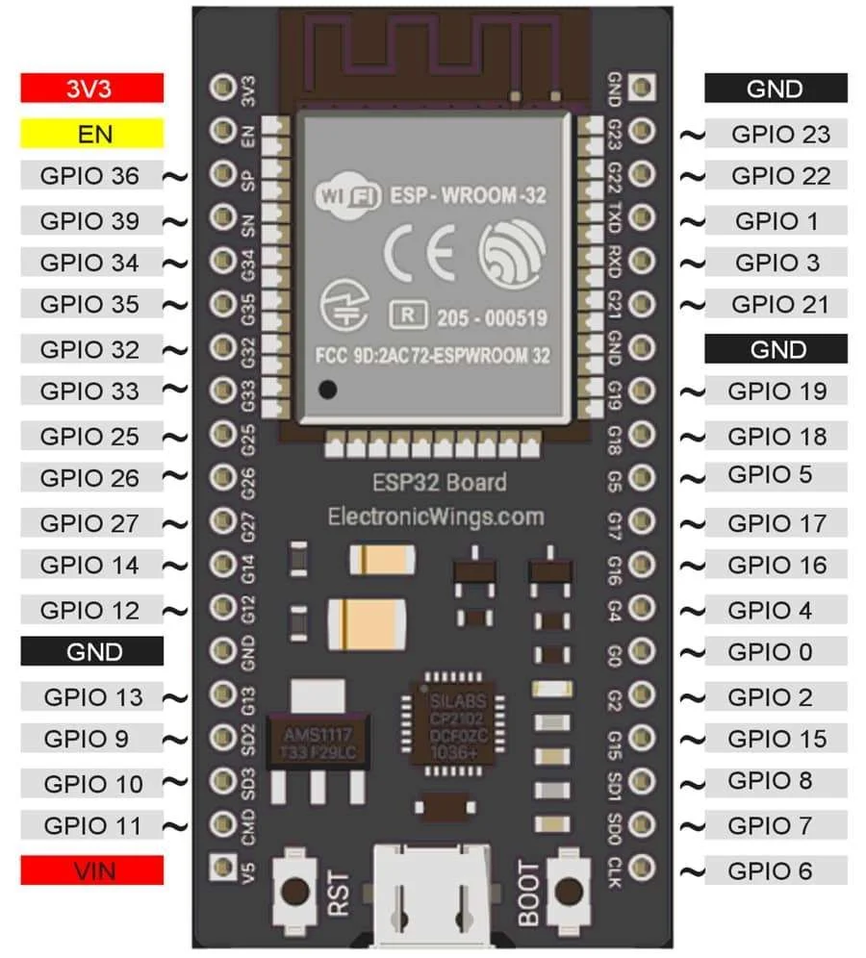
WIFI
P
P1.4
8051
P2.1
P1.3
P1.2
P1.1
P1.0
ESP32
P2.0

